Slide 1
MAJOR PROJECT
CARICHOICE LADDER

Slide 2
Introduction
Our Android app aims for a fresh mind to explore his interests, to check his excel area & to pursue a profession what is most suitable profession the behalf of the score & types of answers given by the individual app will suggest suitable professions in the second layer according to his interests.

Slide 3
Existing Solutions
Present day websites conducts a demo test
On behalf of the demo test, it suggests rating of some soft & hard skills
These ratings shows what is a suitable profession for any individual

Slide 4
Identified Gaps in Existing Solutions
Many websites & apps suggested which kind of profession one must pursue
Some websites are meant for providing detailed information about how to get admitted in a certain profession
Our App aimed at bridging this gap
It first evaluates on behalf of demo test & then suggest a complete of steps to get admitted
It includes colleges name, entrance tests etc

Slide 5
Problem Statement
The Project aims at guiding the right career options for an individual on behalf of the test conduct and then it will provide a detailed database of the chosen profession. It will include all the necessary steps required to get admitted like how to prepare for the relevant exam, prestigious colleges in that domain, etc.

Slide 6
Functional Diagram

Slide 7
Part - 1
Direct Searching by the User

Slide 8
Part - I
The project is divided into two parts
First part is meant for an intelligent user
It is focused for those individuals who have a clear idea about their future profession
A user can directly search the name of their desired profession
Our database will provide them a step by step to pursue their desired course/profession

Slide 9
Part – 2
Test BASED Profession Guidance

Slide 10
Part - 2
Part – 2 is again divided in two sub parts
2(a) – RECOMMENDATION BASED ON TEST –
Here a test is conducted and its scores are evaluated and on behalf of weighted scores, some profession are suggested
Hashing Tables are used for weighted average calculations

Slide 11
Part -2
2(b)- RECOMMENDATION BASED ON PROFILE
Here user inputs a user profile
On behalf of the user profile, a recommendation Algorithm is applied
It takes help from skill set Relation Table
Its expected outcome is a suggested career or the skill set shown to user

Slide 12
HASHED TABLE 1
Ques | Conventional | Artistic | Realistic | Investigative | Enterprising | Social
I like to…… | 0-3 | 0-3 | 0-3 | 0-3 | 0-3 | 0-3
Do puzzles
Work independently
Do experiments
Strict direction
Work outdoor
draw

Slide 13
User is asked to answer the question in the form of rating from 1-10
Weighted points 0-5 are given to every single question according to the relevant importance to attributes

Slide 14
Considering Artistic Attribute
S.No. | Questionairre | User Rating | Weightage | Weighted Rating
 |  | Xi | Wi | XiWi
1 | Do experiments | 5 | 3 | 15
2 | Have clear instructions to follow | 7 | 2 | 14
3 | Pay attention to details | 5 | 5 | 25
4 | Do creative writing | 2 | 5 | 10
5 | Work outdoor | 6 | 5 | 30
6 | Act in plays | 2 | 4 | 8
7 | Day dreaming | 3 | 4 | 12
Sum of Weighted Rating
f(x)=⅀XiWi

Slide 15
FORMULATION
f(x) = ⅀ Xi Wi
Where
x=user rating
W= Weight for the specific Attribute
i= Question Number
f(x) is calculated individually for every attribute

Slide 16
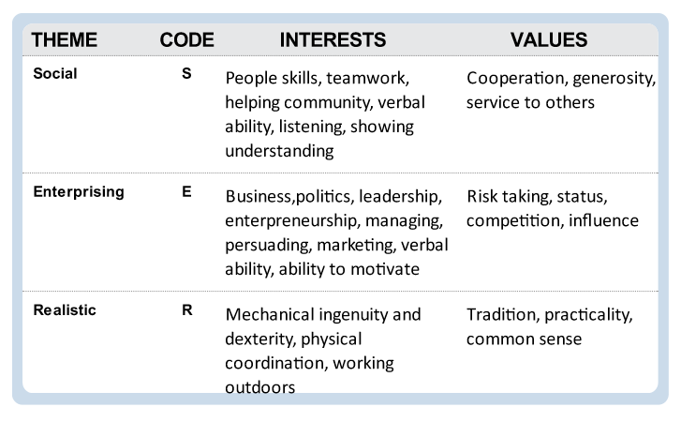
Values required for a Profession

Slide 17
Hash Algorithm - II

Slide 18
Input - HASHED TABLE 2
Conventional | Artistic | Realistic | Investigative | Enterprising | Social
 | Wt1 | f1(x) | Wt2 | f2(x) | Wt3 | f3(x) | Wt4 | f4(x) | Wt5 | f5(x) | Wt6 | f6(x) | Tot
JOB |  | 257 |  | 277 |  | 299 |  | 263 |  | 320 |  | 245 | ⅀fj(x)Wtj
Research | .1 | 25.7 | .1 | 27.7 | .2 | 59.8 | .3 | 78.9 | .15 | 48 | .05 | 12.25 | 252.35
Architecture | .2 | 51.4 | .4 | 110.8 | .2 | 59.8 | .1 | 26.3 | 0.05 | 16 | 0.05 | 12.25 | 276.55
Marketing Executive | .1 | 25.7 | .1 | 277 | .1 | 27.2 | .2 | 52.6 | .25 | 80 | .25 | 61.25 | 247.25

Slide 19
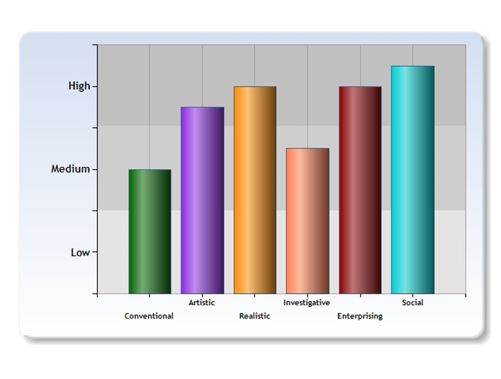
Relation between skill sets & scores

Slide 20
AGGREGATION ALOGRITHM
STEP 1:
((*) Generalized Formula
G(x)= ⅀f _{j}(X) * Wtj
F(x)= Weighted Sum of each column of Hashed Table 1
Wt= Weight of each attribute according to job profession
j= Attribute Number
(*) Specific Example for J=1 to 6
G(x)= f1(x)wt +f2(x)wt +f3(x)wt + f4(x)wt +f5(x)wt +f6(x)wt

Slide 21
STEP 2: Calculate MAX value
G(x) is calculated for all the three professions
Max(G1,G2,G3)
It gives the desired profession.

Slide 22
SNAPshots

Slide 23
SNAPSHOTS

Slide 24
References
www.targetstudy.com
www.careerguide.com
Book- ‘Harvard Business Essentials: Decision Making’
Blog - http://blog.penelopetrunk.com/category/finding-a-career/
Times of India Article - http://timesofindia.indiatimes.com/life-style/relationships/work/How-to-choose-the-right-career-option/articleshow/47766122.cms

